Slide 1
Call Volume Trend Analysis
Zaid Mohammad

Slide 2
Project Description
In this project, "ABC Call Volume Trend Analysis," the goal was to understand how inbound call patterns, durations, and agent workloads impact customer experience and operational efficiency in a call center environment. By analyzing detailed call data over a 23-day period — including queue times, call durations, agent assignments, and call outcomes — the project aims to uncover key trends that drive customer satisfaction and service performance. This analysis is crucial for identifying peak periods, optimizing manpower allocation, improving response times, and reducing abandoned calls, ultimately helping the company deliver a better customer experience and run its inbound operations more effectively.

Slide 3
Tech Stack
MS - Excel
PowerPoint

Slide 4
Data Cleaning
Removed rows with missing Agent_Name or Agent_ID
Fixed column names and typos
Checked for duplicates and removed if found
Reviewed outliers in call durations
Verified consistency of category values (Call_Status, Wrapped_By, etc.)

Slide 5
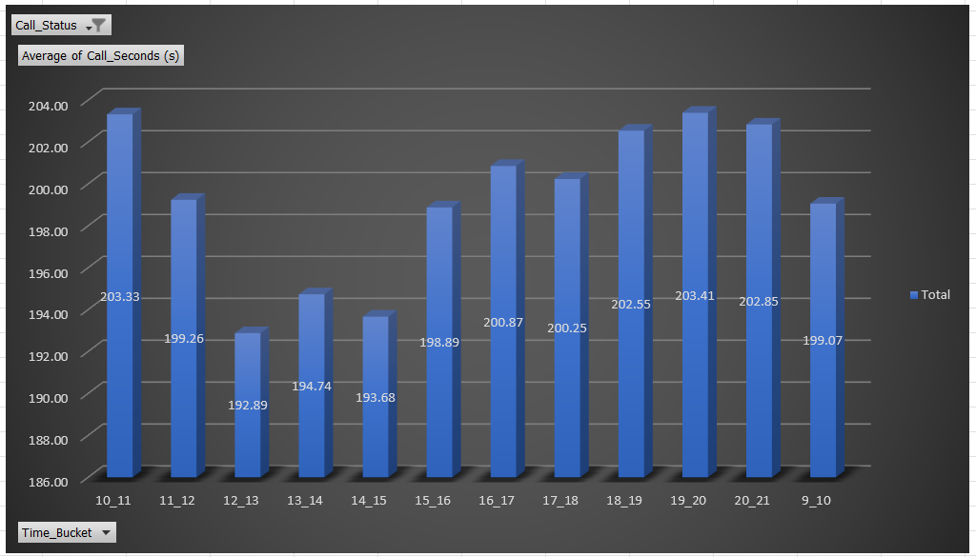
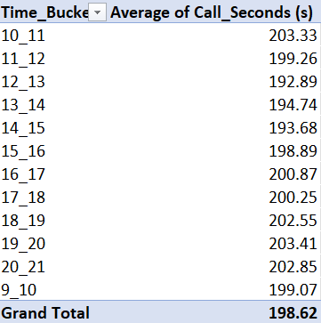
Data Analytics Tasks
Task 1: Average Call Duration per Time Bucket
Insights :
The average call duration was highest during 10_11 and 19_20 and lowest during 12_13 and 14_15, so basically the first hour was very busy then the calls came down till lunch time but in the afternoon they spiked again.

Slide 6
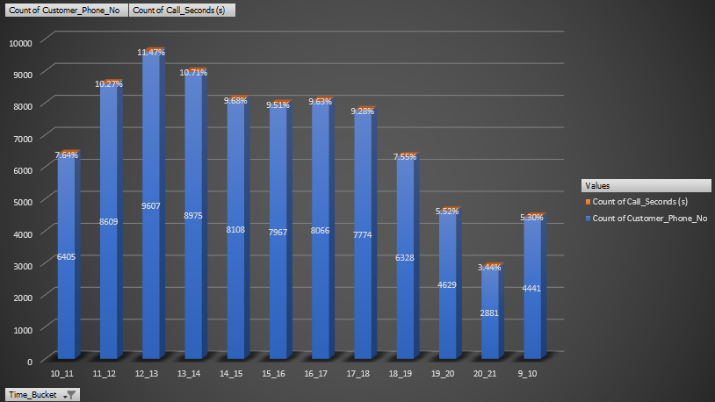
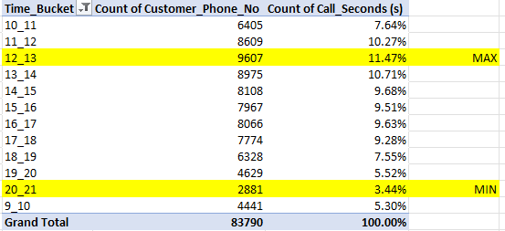
Task 2: Call Volume Trend by Time Bucket (Chart)
Insights :
Call volumes peaked during the early hours and mostly at 12_13 with noticeably lower volumes late hours especially at 20_21. This trend helps identify peak support periods

Slide 7
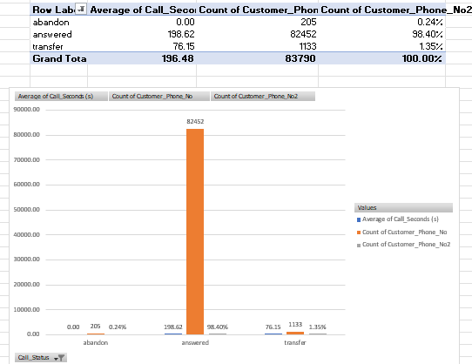
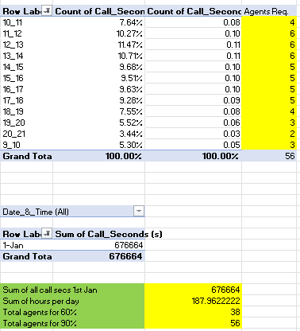
Task 3: Manpower Plan to Reduce Abandon Rate to 10% (9 AM–9 PM)
Insights :
To reduce the abandon rate to 10%, we need at least 56 agents and the picture on the right shows the distribution of the 56 Agents.

Slide 8
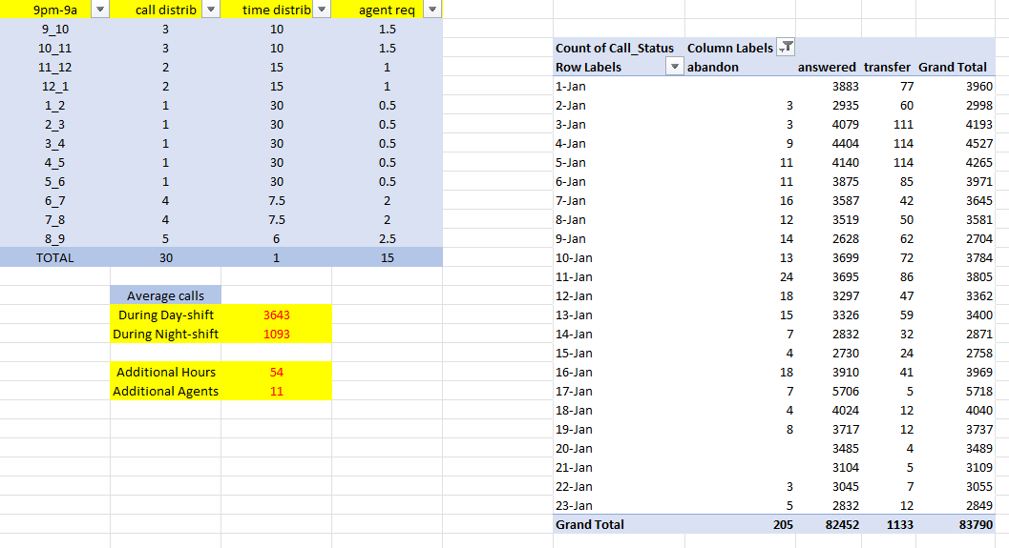
Task 4: Night Shift Manpower Plan (9 PM–9 AM) for 10% Abandon Rate
Insights :
Night shift analysis shows an average of 1,093 calls during night hours, requiring 11 additional agents and 54 extra working hours to maintain the target 10% abandon rate. This highlights the need for dedicated night staffing to improve customer experience and reduce missed calls.

Slide 9
Insights
Through this project, I learned how to analyze call center data to uncover trends, optimize agent staffing, and improve customer experience. By breaking down call volumes, durations, and abandon rates across different time buckets, I understood the importance of data-driven manpower planning and how small operational changes can significantly reduce missed calls and improve service quality.
Excel Sheet Link – https://docs.google.com/spreadsheets/d/1N4G7tDf8xbF88vV_pOY8ivk_OvW4VNjv/edit?usp=sharing&ouid=110673356967982932629&rtpof=true&sd=true

